Slide 1
Diseño de Historias digitales
Digital Storytelling

Slide 2
Elementos de la historia digital (DTS Elements)
Story Purpose
Narrator Experience
Problem of the Story
Problem of the Story
Quality of the Illustrations
Grammar and Language Use
Notes:
There are originally 10 elements in Digital storytelling for the classroom. Pick the relevant ones to my project and grade level.
1. The Overall Purpose of the Story
2. The Narrator’s Point of View
3. A Dramatic Question or Questions
4. The Choice of Content
5. Clarity of Voice
6. Pacing of the Narrative
7. Use of a Meaningful Audio Soundtrack
8. Quality of the Images, Video & other Multimedia Elements
9. Economy of the Story Detail
10. Good Grammar and Language Usage
10. Good Grammar and Language Usage

Slide 3
Historias Digitales - Linea de tiempo del Proyecto
Semana 2: Construcción
El carro STEAM: arte y manualidades
Colaboración con el Artista residente; Jeff Mather
Aprender las dimensiones
Construcción de los títeres
Semana 4
Escribe un guión
Análisis grupal del guión
Introducción de la aplicación My Story.
Crear la historia digital usando la tableta
Semana 3
Conferencias en grupos pequeños de títeres
Practica de lectura
Teatro de titeres
Crear el libreto de la historia.
Crear el guión gráfico.
Semana 1: Inicio del proyecto
Que es una historia digital y como se hace?
Leemos la historia El monstruo de los colores.
Creamos nuestros monstruos y los describimos
Semana 5
Terminar la historia digital usando la tableta
Presentar la historia digital
Notes:
Timeline of the project. It is useful to have this displayed in your class, in that way students can keep track of the progress and progression of the project.

Slide 4
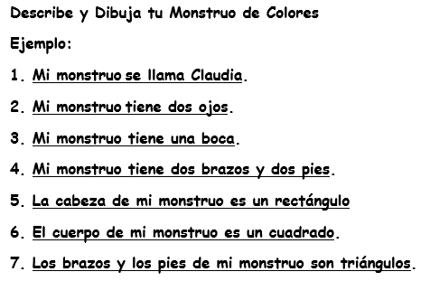
Monster Draft and Description Sample

Slide 5
Reconozco
mis emociones
Alegre
Hoy me siento...
Triste
Enojado
Como me siento hoy?
Asustado
Calmado
Notes:
Use this poster to assess students feeling through the different phases of the project.

Slide 6
Story Circle Etiquette
The main benefit of story circles is that someone who is not as familiar with your topic as you are can provide an objective opinion of your work and make suggestions for how you can revise your script to make it clearer and more appealing to your audience.
When giving feedback
When receiving feedback
Time
1. Be respectful of others and their work.
2. Begin your feedback by saying something like: "If it were my story, I might..."
3. If you have questions about your peer’s script, ask about it in a constructive way.
4. Provide positive feedback.
1. Be receptive to suggestions of others.
2. Ask questions about any portion of the feedback that needs further clarification.
3. Write down the feedback from others.
4. Ask story circle participants if they understand the meaning you are trying to convey.
1. Three to five people in a group.
2. Make sure to note the time limits set by the teacher.
3. One student per group should monitor the time .

Slide 7
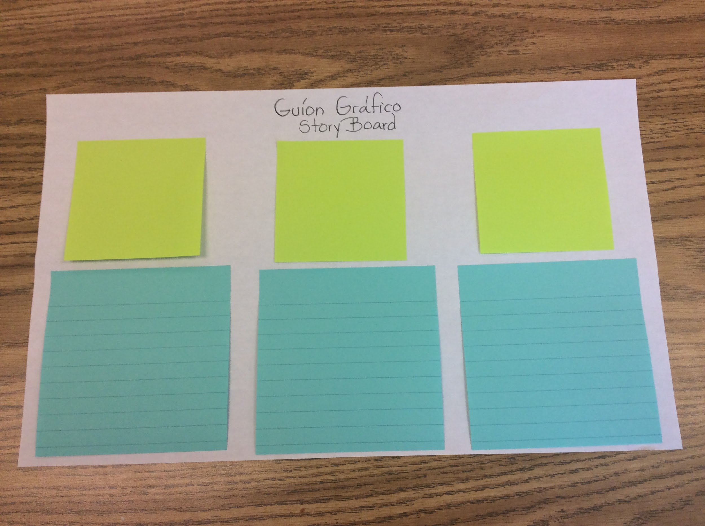
Storyboard – Guíon gráfico
Notes:
There are plenty of storyboard templates, but using post it notes or index cards give flexibility to your students, they can arrange and reorganize their script and images. If you are using storyboard with younger kids use legal size paper.

